Slide 2

Versioning Everything
Code, Data, Config, and Why Partial Versioning Fails

Slide 3


Who is talking to you right now?
Beau Schwieso
2x Microsoft MVP
Nathan Clouse
6x Microsoft MVP

Slide 4

What is running in this environment, exactly, right now?
Not what's in the repo. Not what we deployed last Tuesday. Not what the release notes said.

Slide 5
Why F&O is different
TYPICAL APP STACK
DYNAMICS 365 F&O
Code
Code
+ a config file or two (or ten)
Configuration
Version the code. Done.
Reference data
Master & Transactional data
Environment state
5 things to version — not 1

Slide 6
Five layers of truth
What actually determines how an F&O environment behaves
01
Code
X++ extensions, models, deployable packages
02
Configuration
Module parameters, posting profiles, number sequences, workflows
03
Reference data
Chart of accounts, dimensions, vendor groups, item models
04
Master & operational data
Customers, vendors, items, transactions
05
Environment state
Feature toggles, batch jobs, integrations, security assignments

Slide 7
Layer 1 of 5: Code
01
02
03
04
05
The layer most teams have figured out — and the one we mistakenly generalize from.
WHAT'S IN THIS LAYER
ANTI-PATTERN
X++ extensions in Visual Studio against models
Source control through Azure DevOps
Build pipelines produce a deployable package
Tags, branches, pull requests
A code tag is not a release.
Treating a code tag as a release artifact. A code tag is a slice of one of five layers — not the release.

Slide 8
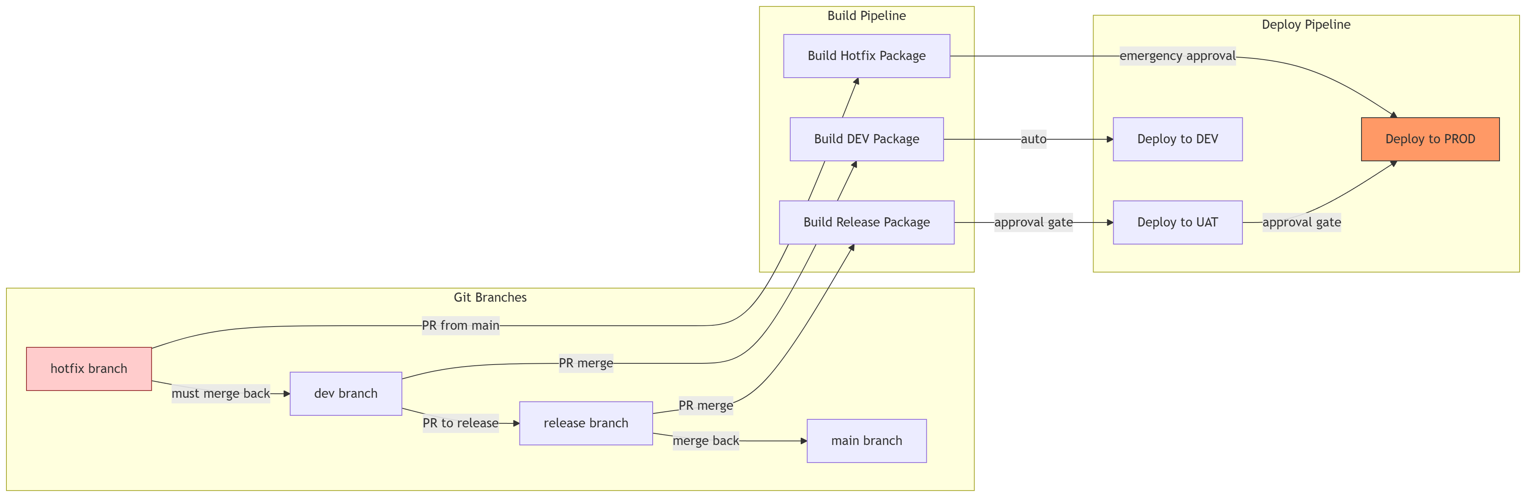
Git

Slide 9
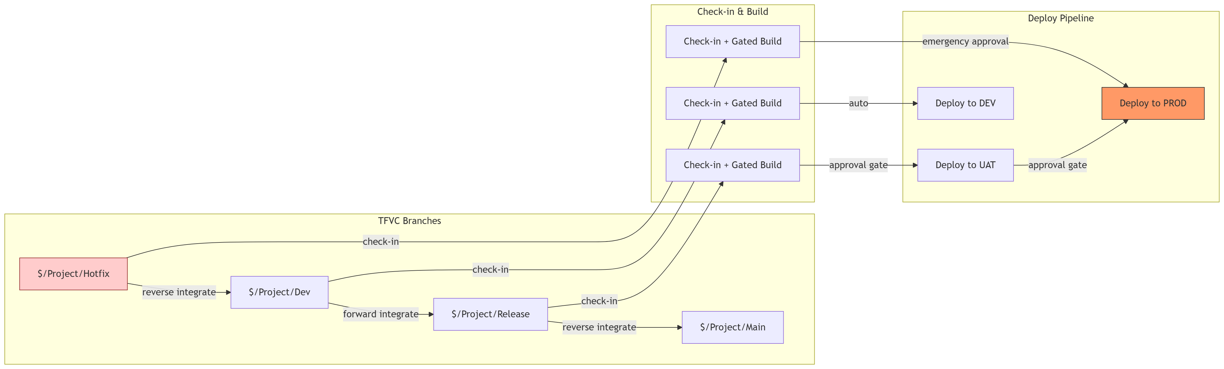
TFVC

Slide 10
Layer 2 of 5: Configuration
01
02
03
04
05
The most under-versioned layer in our entire ecosystem.
WHAT'S IN THIS LAYER
ANTI-PATTERN
Module parameters (GL, AP, AR, Inventory, etc.)
Posting profiles, number sequences, financial dimensions
Workflow definitions and approval matrices
Feature management toggles
DMF + Configuration Data Project
Documents don't deploy.
Configuration documented in Word and Visio, called "the source of truth." Documents do not deploy. Documents do not detect drift.

Slide 11
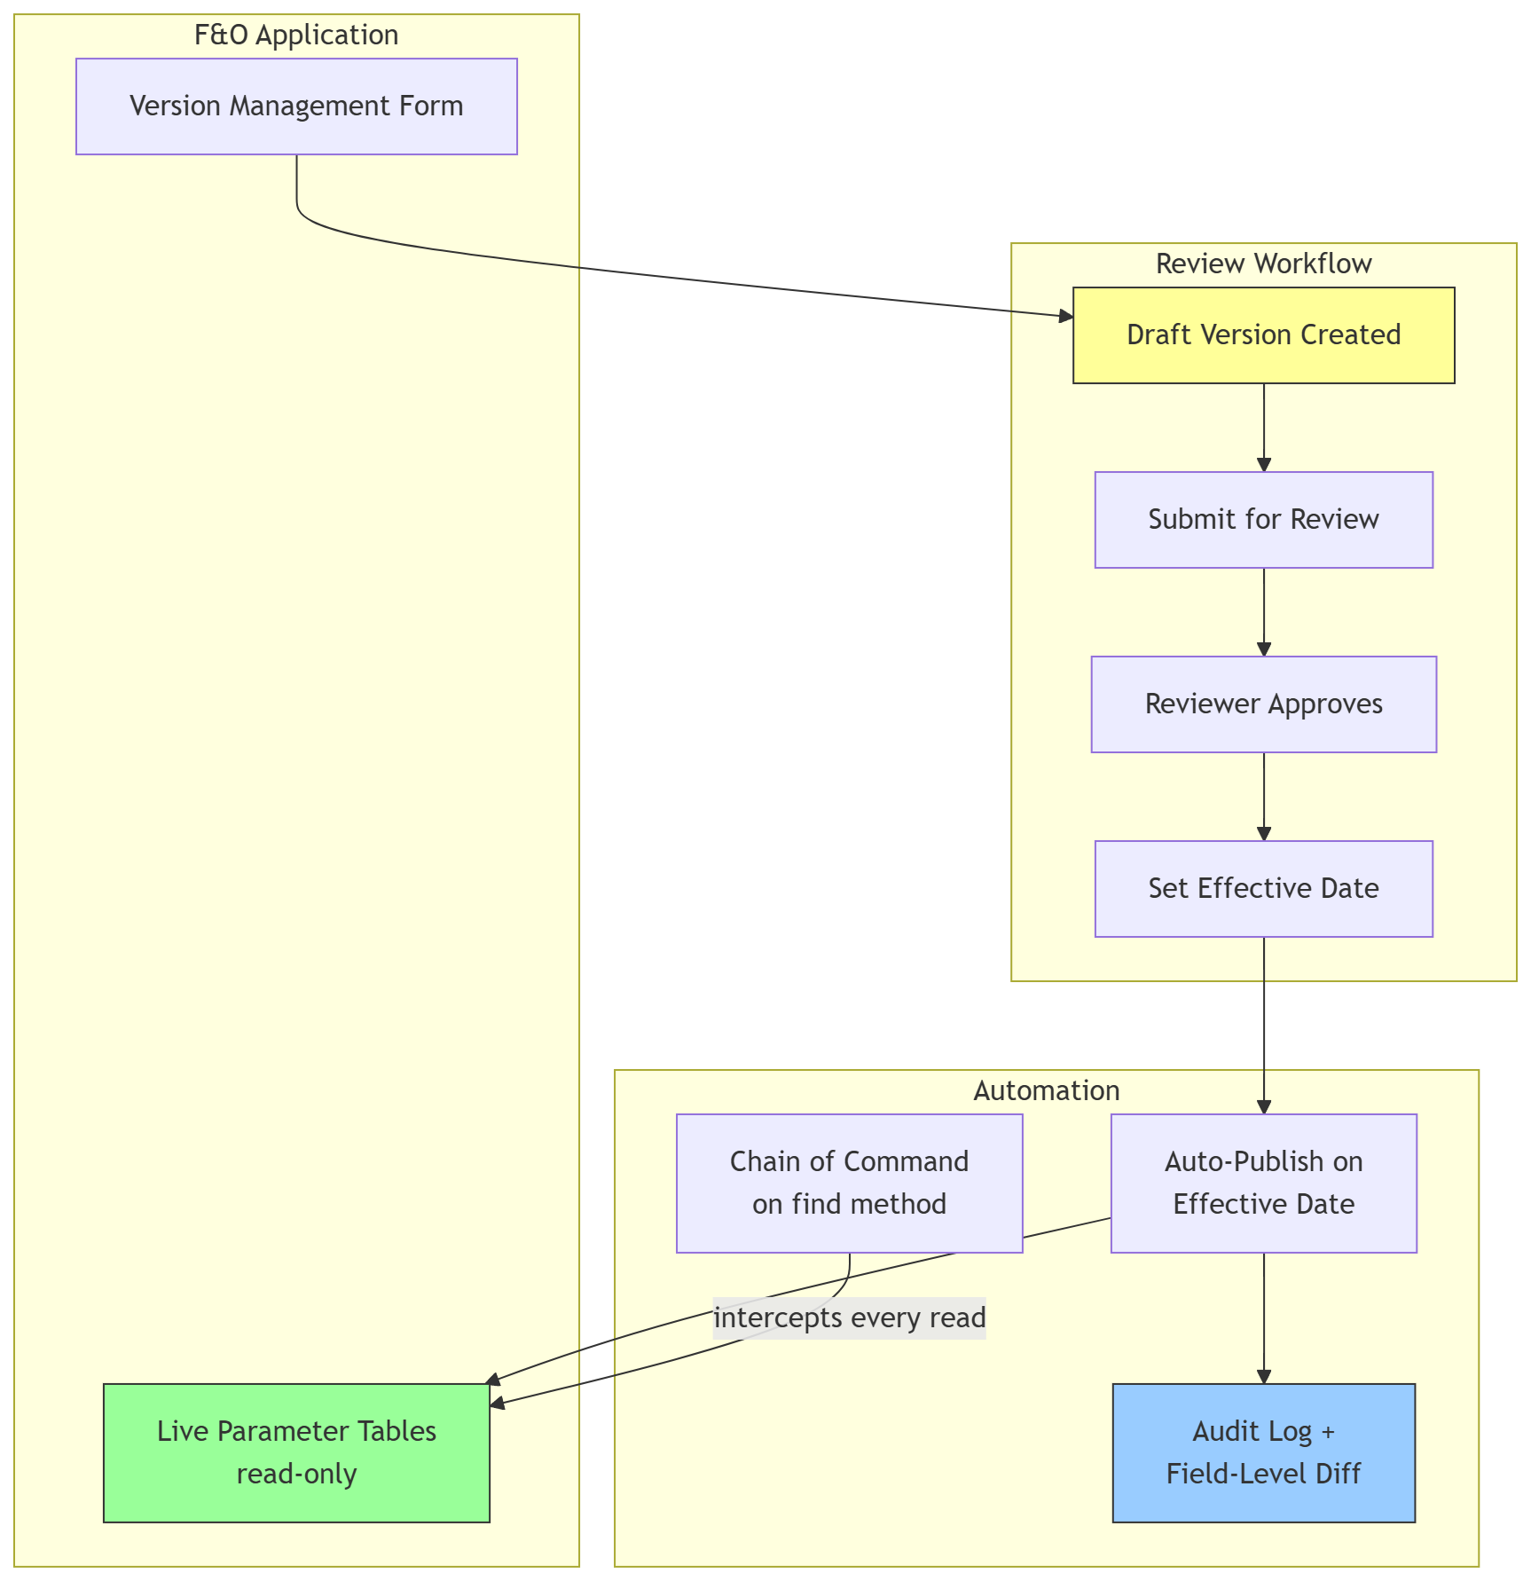

Slide 12
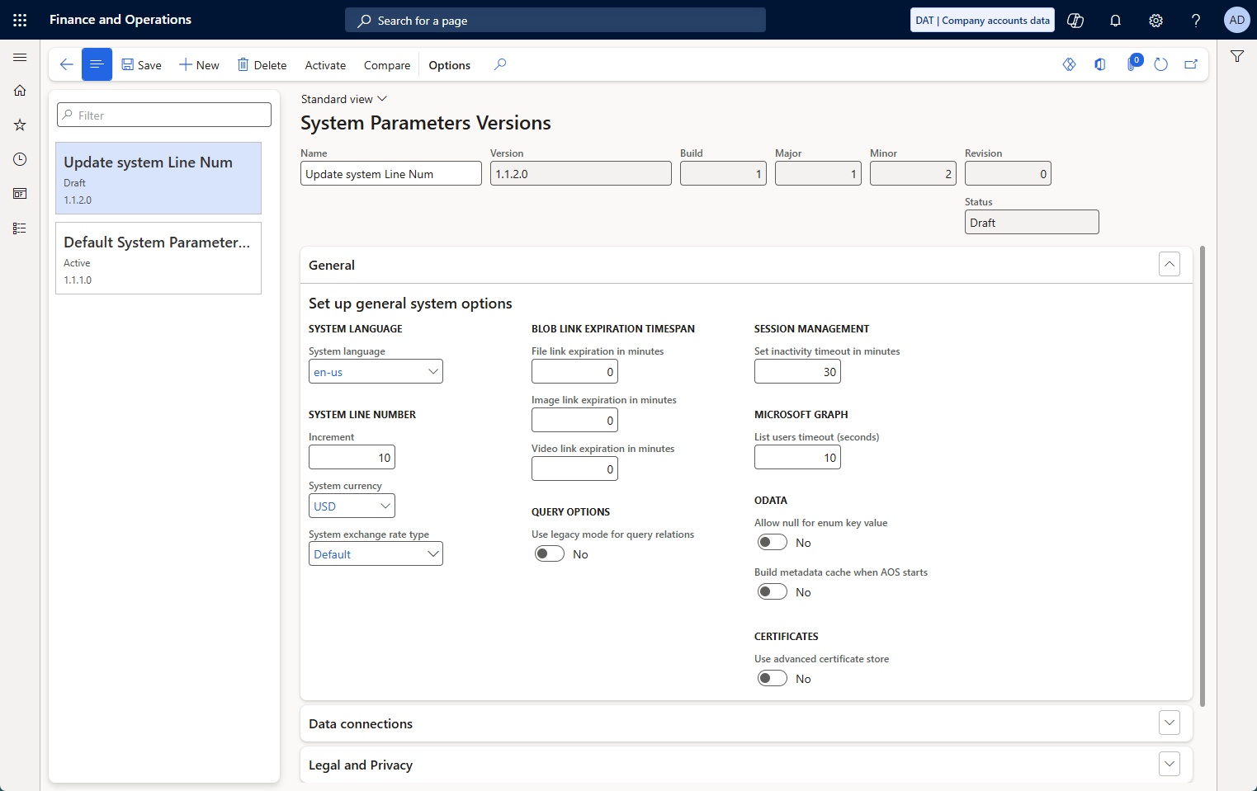
Open-Source Example
https://github.com/NathanClouseAX/AAXParameterWorkflow
Notes:
- Original parameter forms locked to read-only -- all changes flow through version management
- Users create Draft versions, modify values, submit for review
- Reviewer approves in-app -- no external system needed
- Effective date set; automation publishes values when date arrives
- Chain of command on `find()` intercepts every parameter read -- seamless to consuming code
- Every version is a snapshot with field-level diffs for audit

Slide 13
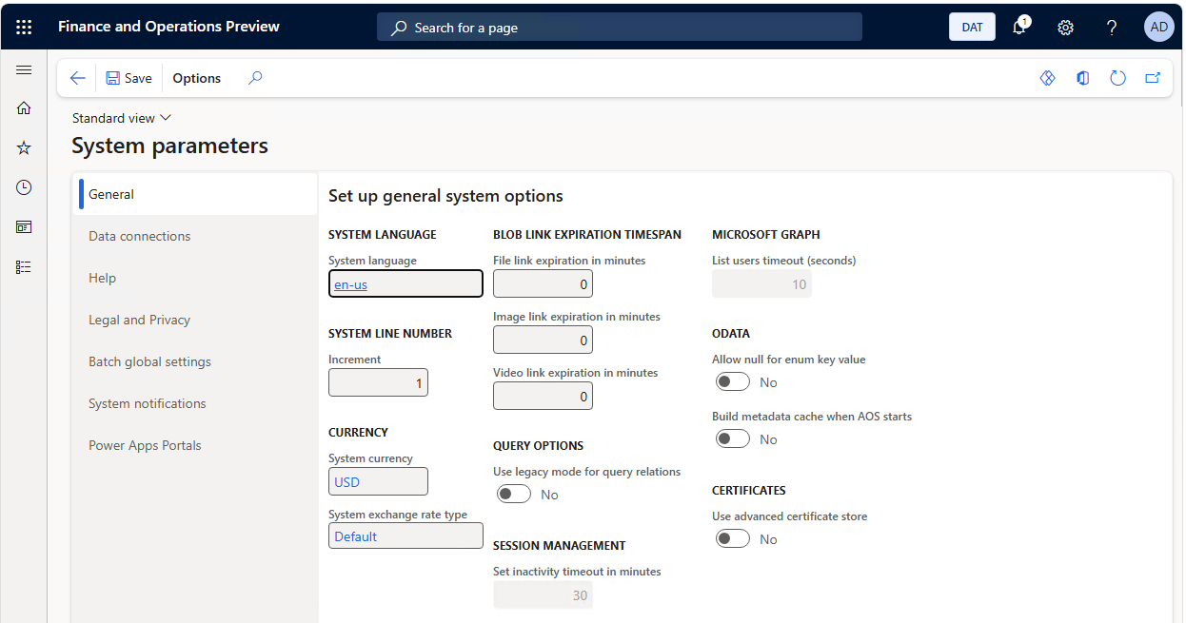

Slide 14
Layer 3 of 5: Reference data
01
02
03
04
05
The structures the business runs against — set once, then drifted forever.
WHAT'S IN THIS LAYER
ANTI-PATTERN
Chart of accounts and account structures
Financial dimensions and default dimensions
Vendor groups, customer groups, item models
Payment terms, terms of delivery, tax codes
The boundary between config and data
Go-live is not the end-state.
Reference data treated as a one-time go-live event. Once a structure exists in PROD only, every future test against it is theatre.

Slide 15
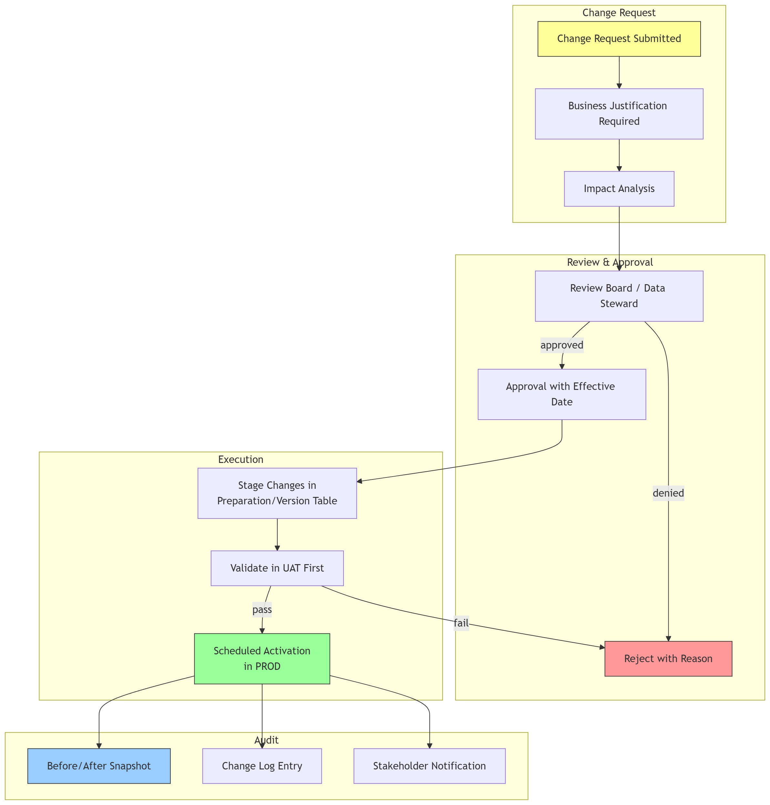
Notes:
Consider changing a chart of account or adding a new main account

Slide 16
Layer 4 of 5: Master & operational data
01
02
03
04
05
Not normally versioned — but refreshes from PROD silently rewrite layers 2 and 3.
WHAT'S IN THIS LAYER
ANTI-PATTERN
Customer, vendor, item, employee records
Transactions, ledger postings, inventory movements
Moved through database refreshes (PROD → UAT)
Backup, restore, and Microsoft database movement tooling
A refresh is a config event.
Database refreshes treated as risk-free. A refresh is a configuration event, not just a data event — your repo and the refreshed environment now disagree.

Slide 17
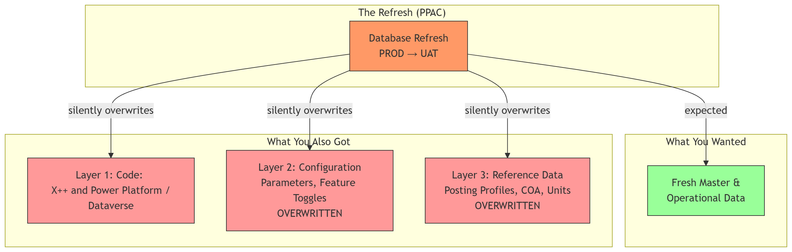

Slide 18
Layer 5 of 5: Environment state
01
02
03
04
05
Doesn't fit anywhere else — and almost never gets versioned.
WHAT'S IN THIS LAYER
ANTI-PATTERN
Feature management toggles
Batch job schedules and statuses
Integration endpoints and connection strings
Service accounts and certificates
Security role assignments
Every toggle is a fork.
Feature management toggles flipped per-environment with no central inventory. Every toggle is a behavioral fork.

Slide 19
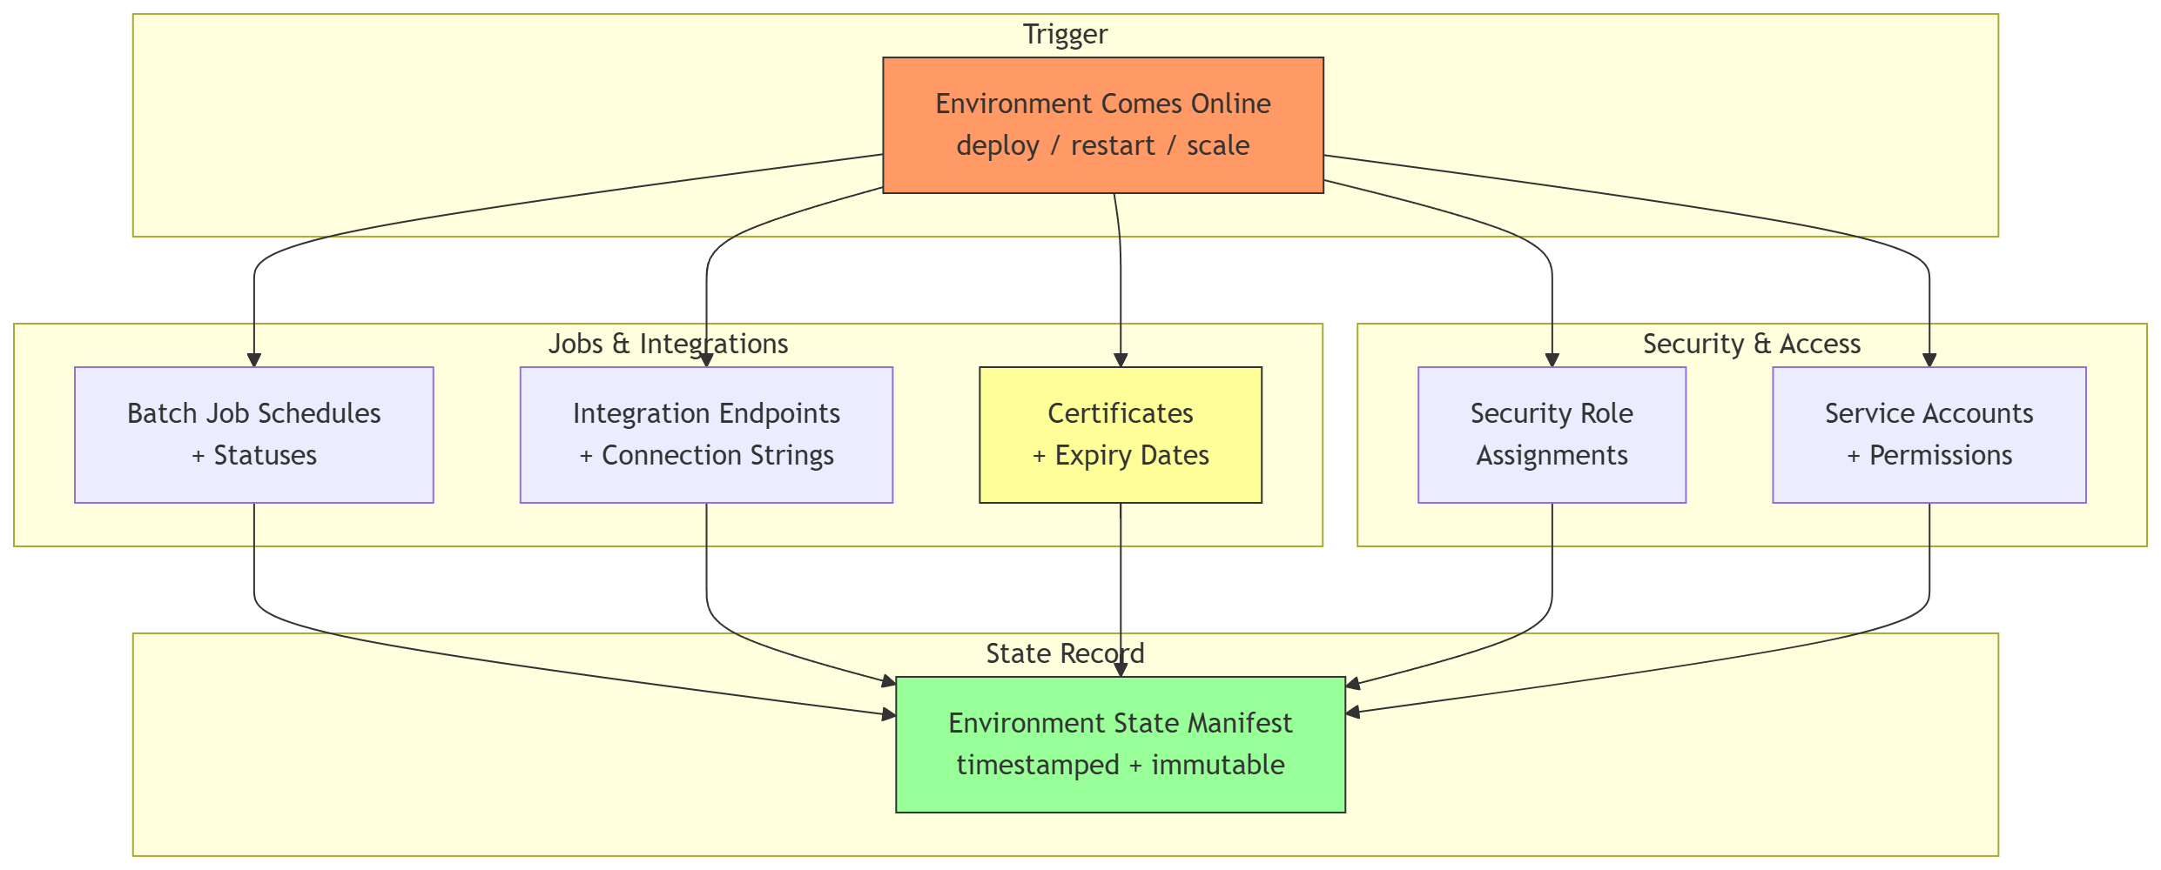

Slide 27
Score yourself
ARE YOU DOING THIS?
HANDS UP
Code
In source control, tagged, built by a pipeline?
Almost everyone
Configuration
Configuration Data Project exported on a schedule? Or system-based workflow?
A lot fewer hands
Reference data
Idempotent loads in source control?
Even fewer
Master/operational
Refresh process documented and automated?
Mixed
Environment state
Inventory of toggles, batch jobs, endpoints?
Maybe one or two

Slide 28
“We version our solution”
WHAT IT SOUNDS LIKE
Reproducibility
Rollback
Traceability
At the solution level
Partial versioning is not safety. It is the appearance of safety.
WHAT IT USUALLY MEANS
We tagged the X++ repo on release day
That's it
A fraction of one layer

Slide 29
DEV ≠ UAT ≠ PROD
Same code. Different environments. Different behavior.
DEV Tier-1 cloud-hosted developer box
Different sizing · Mixed local + service settings · Personal feature toggles
UAT Tier-2 sandbox
Test integrations · Refreshed periodically from PROD · Selective feature toggles
PROD Production
Live integrations · Microsoft release-wave toggles · Real batch volume
If you've ever had a defect that reproduced in UAT but not DEV — that's this gap in your defect log.

Slide 30
Tribal knowledge is a dependency
“Sarah will know how that's configured.” · “We need to ask Mike before we change that.” · “Whatever Anita set up at go-live is still there.”
Names are a brittle storage format. Heroes scale badly. Systems scale well.

Slide 31
Six failure modes worth saying out loud
Hotfix that never flows back — Lower environments quietly become non-representative.
Configuration documented in Word — Documents do not deploy. Documents do not detect drift.
Reference data seeded once — Updated by hand thereafter. Drift is silent and permanent.
Toggles flipped per environment — No central inventory. Every toggle is a behavioral fork.
Batch job tuning lives in PROD — Schedules and parameters captured nowhere.
Workflow approvers as data — Treated as configuration only when something breaks.

Slide 32
Five principles for versioning everything
From diagnosis to prescription
01 Configuration as code — Source-control your Configuration Data Project exports.
02 Reference data as code — Idempotent, environment-aware loads.
03 Declarative environments — Rebuild from a manifest, on demand.
04 Journal every PROD edit — Capture intent, not just the change.
05 The manifest of truth — One artifact, five jobs.

Slide 33
Principle 1: Configuration as code
Export your Configuration Data Project. Source-control it. Schedule it.
HOW IT WORKS
Run the Configuration Data Project export against a known-good environment
Commit the export to source control — daily is better than weekly
Use the same artifact to seed UAT, replay PROD, and diff drift
WHY IT MATTERS
Once configuration lives in source control, you get every tool source control gives you for code: history, blame, diffs, and automatic detection of “somebody changed something.”

Slide 34
Principle 2: Reference data as code
Files in the repo. Idempotent loads. Environment-aware.
HOW IT WORKS
Reference data lives in the repo as structured files (CSV, package, or DMF project)
Loads are idempotent — safe to re-run on a partially-loaded environment
Loaders accept an environment target so DEV/UAT/PROD seed correctly
WHY IT MATTERS
‘Idempotent’ is what makes reference-data-as-code actually safe. You can converge on the desired state from any starting state — same job seeds new environments and reconciles drift in old ones.

Slide 35
Principle 3: Declarative environments
If you cannot rebuild it from a manifest, you do not own it.
HOW IT WORKS
Each environment has a description in the repo: code version, config version, reference data set
The manifest also names: feature toggles, batch jobs, integration endpoints
Rebuild process consumes the manifest and produces a like-for-like environment
WHY IT MATTERS
The manifest is the input to two automated jobs: the rebuild, and the drift check. If both are wired up, you have a real versioning system. If neither is, you have a wiki page.

Slide 36
Principle 4: Journal every PROD edit
If you must edit PROD, journal it. Every. Single. Time.
HOW IT WORKS
A row per change: timestamp, user, what changed, why, and rollback path
Even a shared OneNote works — perfect tooling is not the goal, capture is
The platform audit log catches the change. The journal captures the intent.
WHY IT MATTERS
The journal lets you start measuring how often you edit PROD outside a release. That measurement is the first step to editing it less.

Slide 37
Principle 5: The manifest of truth
MANIFEST of truth
Rebuild — Recreate the environment
Drift check — Detect what changed
Audit — Answer the auditor
Onboarding — Brief a new team member
Honest release notes — Not fiction, fact
One artifact. Five jobs. Stays current because everyone needs it to.

Slide 38
The maturity ladder
Find your team
L0 Code repo tagged — Nothing else captured. Most teams when honest.
L1 Plus occasional config exports — Better than nothing. Not yet a system.
L2 Plus automated config + reference data — Source-controlled. Realistic target for most projects.
L3 Declarative environments — Rebuild from manifest is rehearsed, not theoretical.
L4 Continuous reconciliation — Drift detected automatically, not discovered.

Slide 39

L0 → L2 is the highest-leverage move
L0 → L1 → L2 → L3 → L4
Code only · Code + occasional · Code + automated config + ref data · Declarative · Continuous
The meaningful jump
Everything above L2 is refinement.
Everything below L2 is exposure.

Slide 40
Partial versioning is fake safety
The word ‘version’ implies reproducibility, rollback, and traceability. If only one of your five layers is versioned, you have none of those properties at the solution level.
The rest is hope. And hope is not a release strategy.

Slide 41
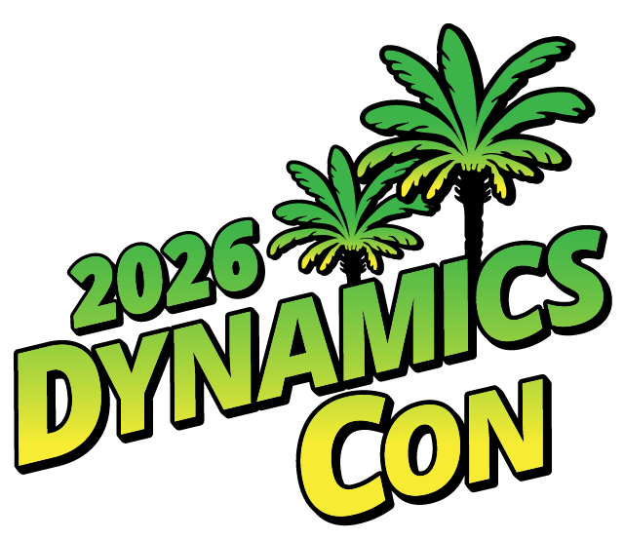









Three things to do Monday
01 Inventory your layers
Spend an hour writing down what isn't in your repo. Five layers. List the gaps. That list is your roadmap.
02 Close one drift surface
Pick the highest-leverage one — usually automating Configuration Data Project export. Just one. This week.
03 Stop the bleeding in PROD
Establish a rule and a journal for any PROD change outside a release. OneNote is fine. Capture intent.

Slide 42
Shameless Plugs
https://github.com/NathanClouseAX/PPACEnvironmentPrototyper
  Create environments in PPAC, build a plan, execute the plan, call out differences against the plan
https://github.com/NathanClouseAX/EnvironmentDataLoader
  Build DMF pipeline automations for PowerShell to get data in, out, add workflows around data, etc

Slide 43

Questions
Pushback welcome.
War stories more so.
Thank you.

Slide 44
Feedback / Questionnaires

